Slide 1



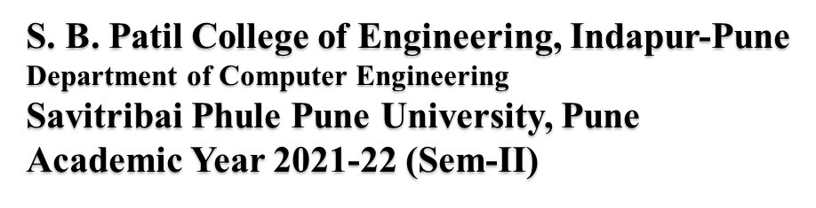
A Internship Presentation Presented By Mind Rushikesh Satish Roll No.: 89 Third Year Computer Engineering

Slide 2
Contents
Problem Statements
Algorithm
Project Prerequisites
System requirements
Implementation
Output
Advantages
Conclusion
Result
Reference
2

Slide 3
Introduction:-
The world is a book, and those who do not travel, read only a page”. These words quoted by Saint Augustine, a fourth- century philosopher, much reflect what travel is all about. Travel around the world to explore new places, know different cultures, traditions, people and cuisines, and enrich yourself with these precious experiences. Visit some of the best places in the world and create memories that you will cherish forever.
Nature and human excellence have contributed together to create the best places to visit in the world. Cities with marvellous architecture, places with reminisces of age-old history, destinations located in the lap of nature and towns with religious importance are counted as some of the famous places in the world. Take a look at some of the best places in the world and craft your travel bucket list.
3

Slide 4
Problem Statement :
People with disabilities have a right to, and want to enjoy travel and leisure experiences. However, their travel experiences are still characterised by transportation constraints, inaccessible accommodation and tourism sites, and inadequate customer services (UNESCAP, 2002
People with disabilities have a significantly different tourism experience. For many travellers with disabilities, a situation like the following is a familiar one: public transportation is difficult and often not accommodating, and/or hotel rooms do not always meet accessibility codes. Many constraints and barriers exist, and general physical access is still the major constraint encountered by people with disabilities (Darcy & Daruwalla, \999). Avoiding barriers to travel require great skill and patience on the part of the traveller (Turco et ai., 1998:79).
4

Slide 5
ALGORITHM STEPS:-
Start
Read name & print
3.Define Calculation
4.Read choice
5.Enter Subchoice
6.Initialize loop
7.If choice is 0, break the loop
8.End
5

Slide 6
Project Prerequisites:
HTML : HTML stands for Hyper Text Markup Language.HTML is the standard markup language for creating web pages.HTML describes the structure of a web page. A strong understanding of HTML is essential.
CSS : CSS stands for Cascading Style Sheets. CSS describes how HTML elements to be displayed on screen ,paper,or in other media. CSS saves a lot of work. It can control the layout of multiple web pages all at once.External style sheets are stored in CSS files.
Libraries and Frameworks: Gain knowledge of relevant libraries and frameworks used in the project.
Development Environment: Set up a suitable development environment for HTML and CSS scripting language. Choose an IDE (Integrated Development Environment) such as Visual Studio Code and ensure you have the necessary.
Project Planning and Management: Familiarize yourself with project management methodologies such as Agile or Scrum. Break down your project into manageable tasks, create a timeline, and set realistic goals.
7

Slide 7
Software Requirements
HTML and CSS
Libraries
Visual Studio Code
Hardware Requirements
PC / Laptop
Minimum Ram - 2GB
Maximum Ram – 4GB /8GB /16GB • Windows - 10 and Above
Processor - Intel i5 / AMD Ryzen
10

Slide 8



IMPLEMENTATION
APPLICATION : HTML, CSS, Visual Studio Code

Slide 9
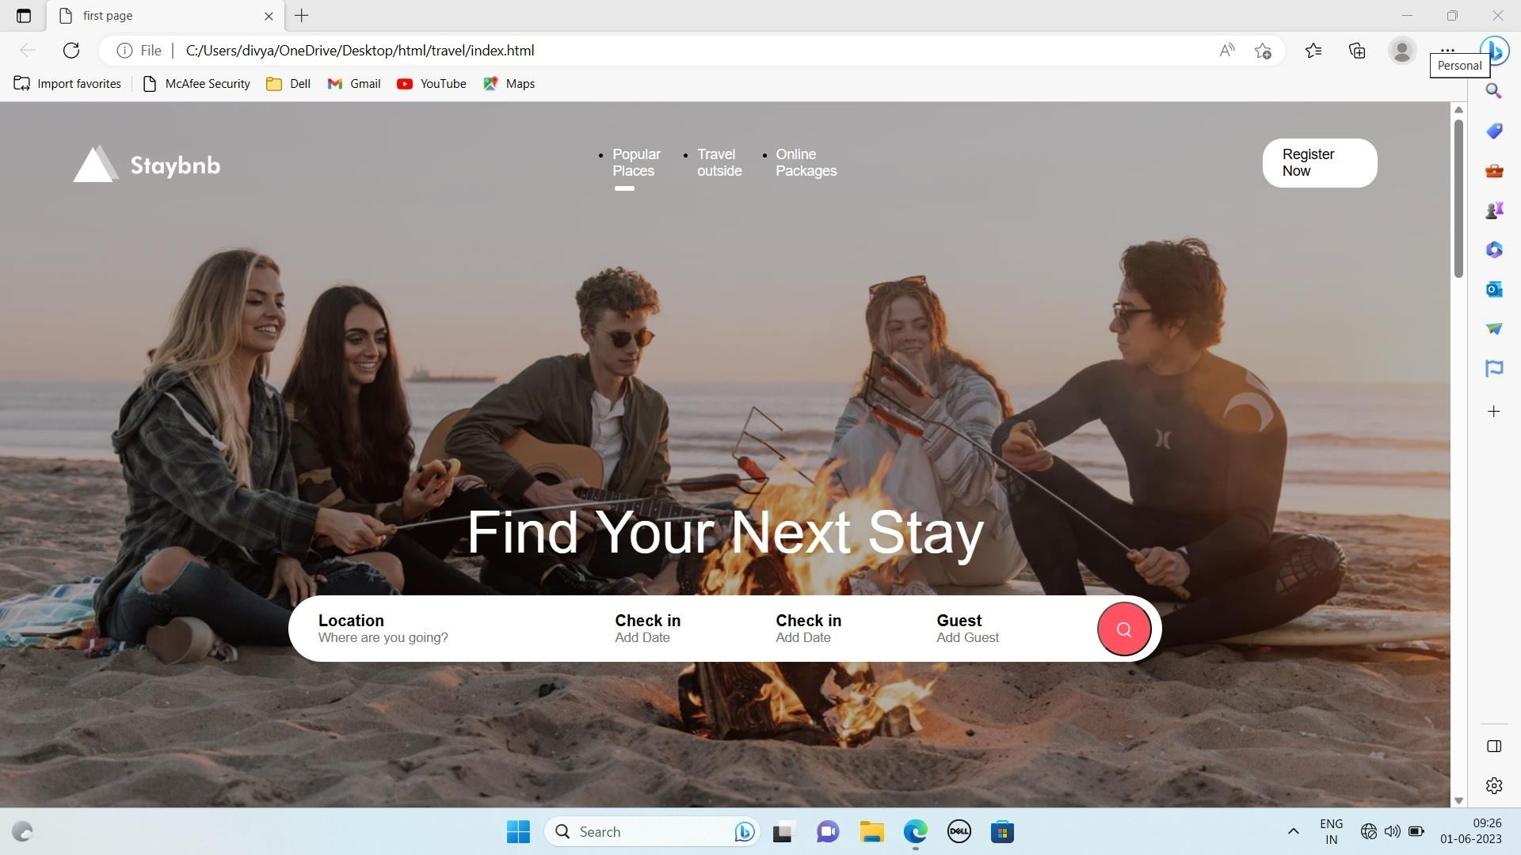
OUTPUT :

Slide 10
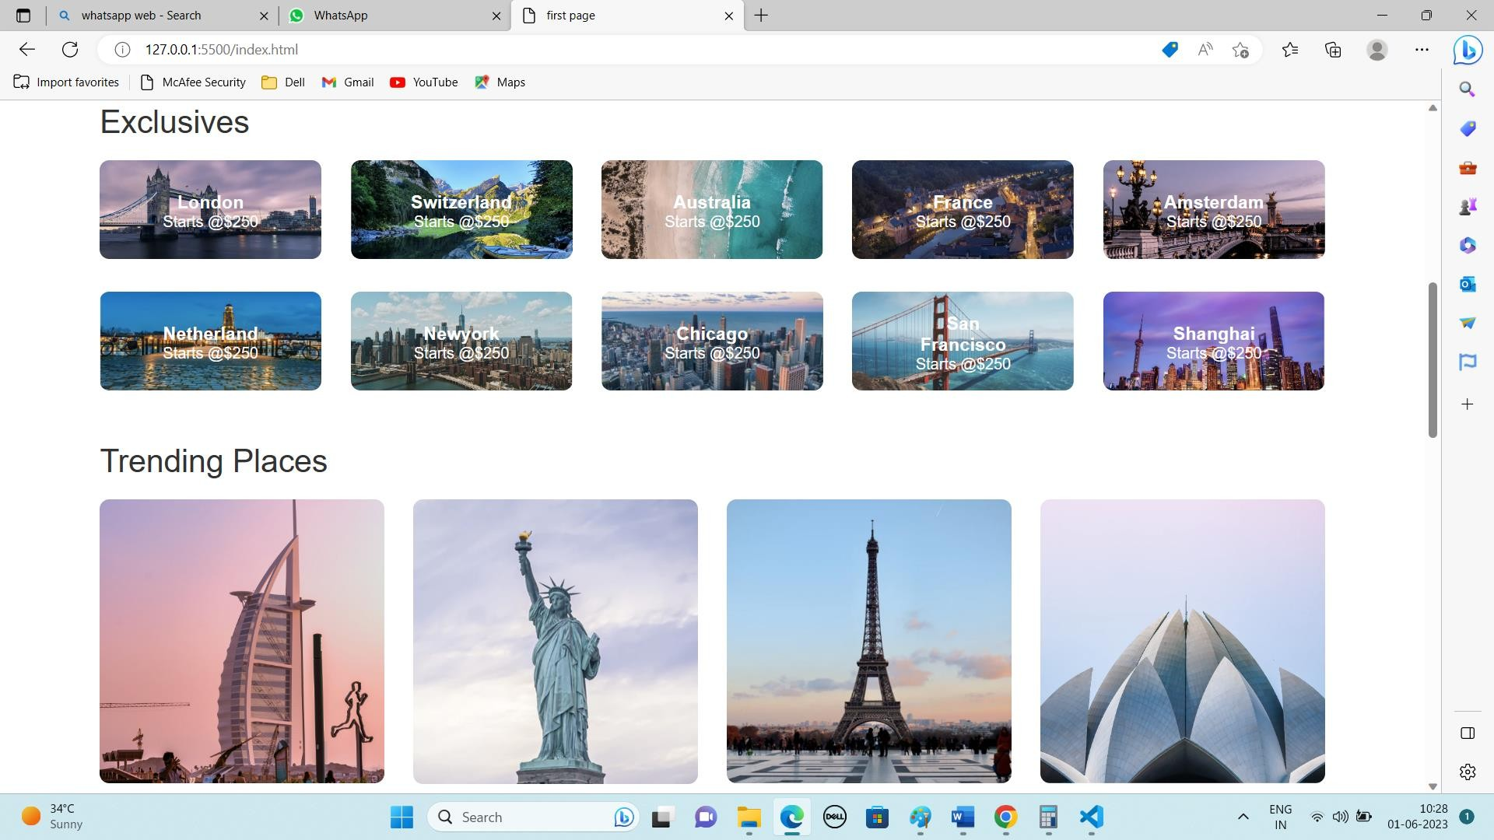

Slide 11
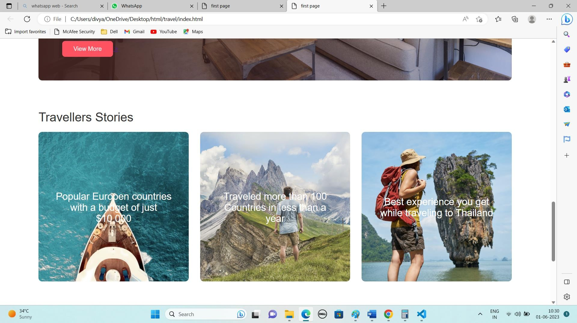

Slide 12
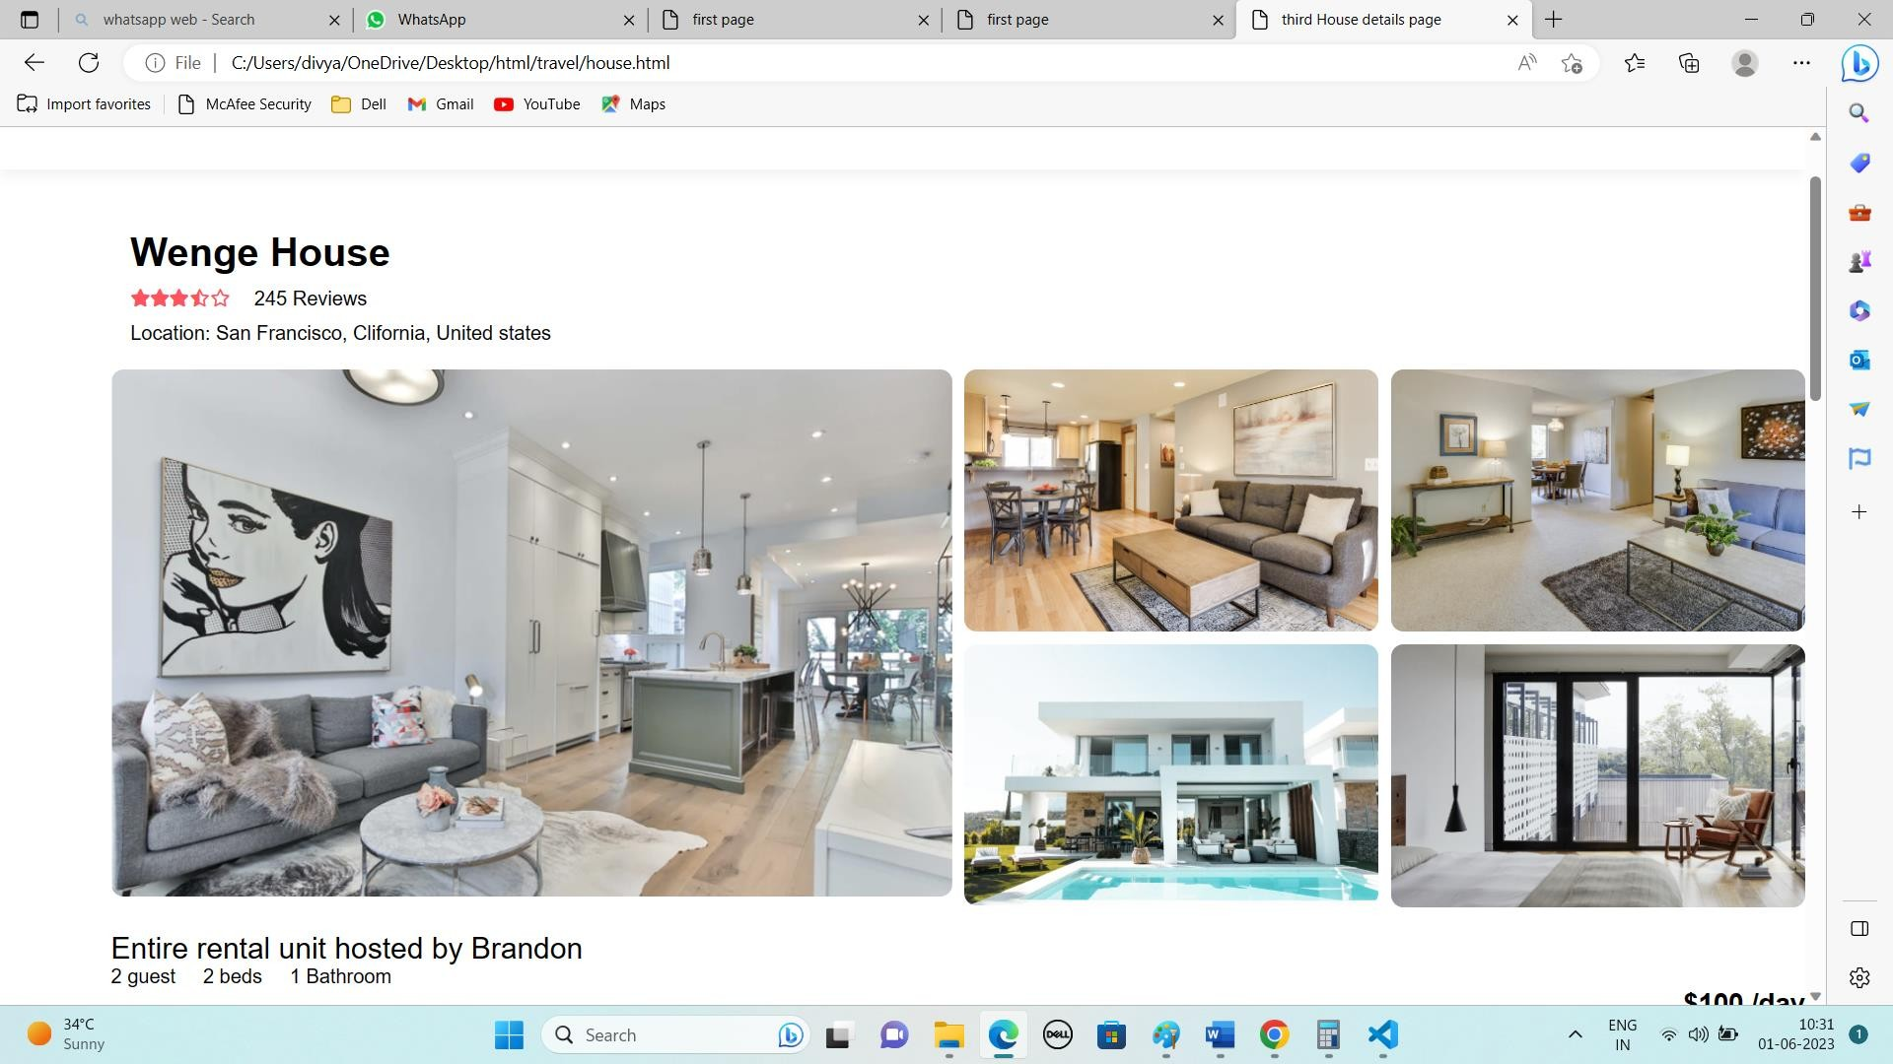

Slide 13
Advantages of Travelling Staying Places:
. Adventures and New Experiences : Without a doubt,the biggest plus to travelling is all of the new experiences you will get across the world.
. Experience new cultures.
. Personal growth.
. Lower cost of living.
. Make new friends.
. It can be expensive
. Sickness.

Slide 14
Conclusion:-
E-commerce is becoming increasingly prominent in tertiary business. e-commerce is an emerging and quickly developing direction in trading. It simplifies the way we sell and buy, but may be dangerous and create frauds. E-commerce still represents one of the business methods that take advantage if done the right way, even if the stock market and commodities fell, but E-Commerce still able to survive and receive high transaction. E-commerce has a tremendous opportunity in the course of business.
18

Slide 15
RESULTS:
19
Staying places are useful for the home owner to earn money. Traveller have a easy way to find location,check in date .
HTML and CSS is easily understand and enjoyed
through this website, technology makes easy to find location in great way.
20

Slide 16
Reference:-
The HTML Help tag reference provides information on HTML color values ,HTML elements ,HTML attributes and cascading style sheet attributes.
The CSS reference to browse an alphabetical index of all of the standard CSS properties ,pseudo-classes, pseudo- elements, data types , functional notations and at-rules.
To link the CSS to an HTML file, we use the< link > tag inside the HTML <head> section.
21

Slide 17
Thank You!!!
22

